Slide 1
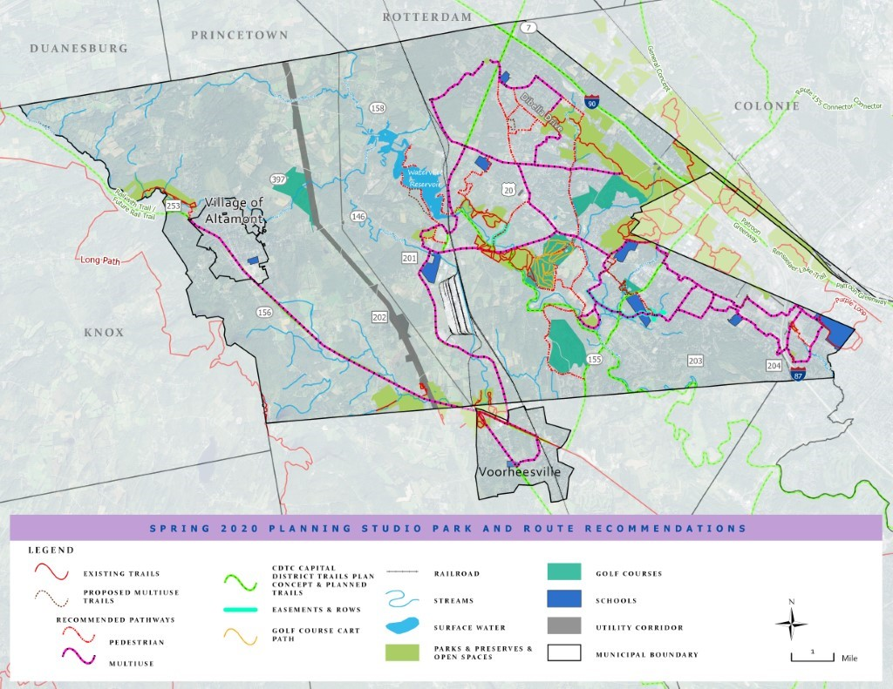
Trail Connectivity Conceptual Plan Spring 2020 Planning Studio and Town of Guilderland
Instructor: Kathleen Maynard
Students: Shannon Clarke, Shannon Connolly, Erika Corsi, Hannah DeLude, Gregory Isoldi, Henry Lino, Nick Schupp, Nathan Seper, and Adam Tobey
Notes:
Hello Everyone, I hope everyone is staying safe and are doing well under these circumstances. My name is Henry Lino and it is my pleasure to introduce the trails and open space project on behalf of the studio team.

Slide 2



Introduction
The town of Guilderland has partnered with the University at Albany Master of Regional Planning program to begin advancements with the trails/open space project.
Developing and redeveloping multi-use trails that would link residential neighborhoods. Overall assessment of parks, open spaces, residential developments, and other existing conditions.
Review of prior planning studies, and historical background assessment.
Community engagement strategy and public meeting.
Further Identify key destinations Guilderland.
Notes:
Hello Everyone, I hope everyone is staying safe and are doing well under these circumstances. My name is Henry Lino and it is my pleasure to introduce the trails and open space project on behalf of the studio team.
The town of Guilderland has partnered with the University at Albany Master of Regional Planning program to begin advancements with the trails/open space project. This project consisted of developing and redeveloping multi-use trails that would link residential neighborhoods. Which included the overall assessment of parks, open spaces, residential developments, and other existing conditions.
Identifying potential local and regional connections that already exist was essential towards providing new proposed recommendations. This planning process required several key assessments. The review of prior planning studies provided a holistic approach to the project engagement.
I is imporant to understand how the historical sites can be incorporated into the overall trails system. This will allow crucial aspects within Guilderland’s history to serve within the trail aesthetics. Making history an important component to the everyday usage of trails. Community engagement strategy helped students and planners analyze vital community information that may have been included in research. The studio team held a public meeting to engage different groups within Guilderland to better understand what is required. The selected town destinations are all within Guilderland.

Slide 3
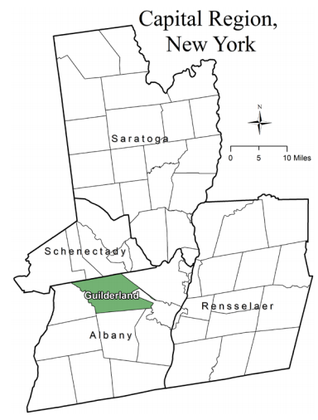
Community Profile
Incorporated in 1803
Population of roughly 35,300
2050 population projection of roughly 38,400
Median resident age of 41.5 years
Median household income $90,465
Avg. commute to work is 15-20 minutes
Notes:
In order to plan for the future of Guilderland, it is crucial to consider the town’s past and current characteristics. The community profile is important in the class’ scope of work and was used as a starting point. It was a helpful way to gain an understanding of the geographical area, but more importantly, the wants and needs of its residents. The suburban town is rich in character and the ultimate goal was to enhance the its vibrant and historic nature within the scope of work by improving connectivity between Guilderland’s popular destinations prioritizing multimodal transportation options.

Slide 4
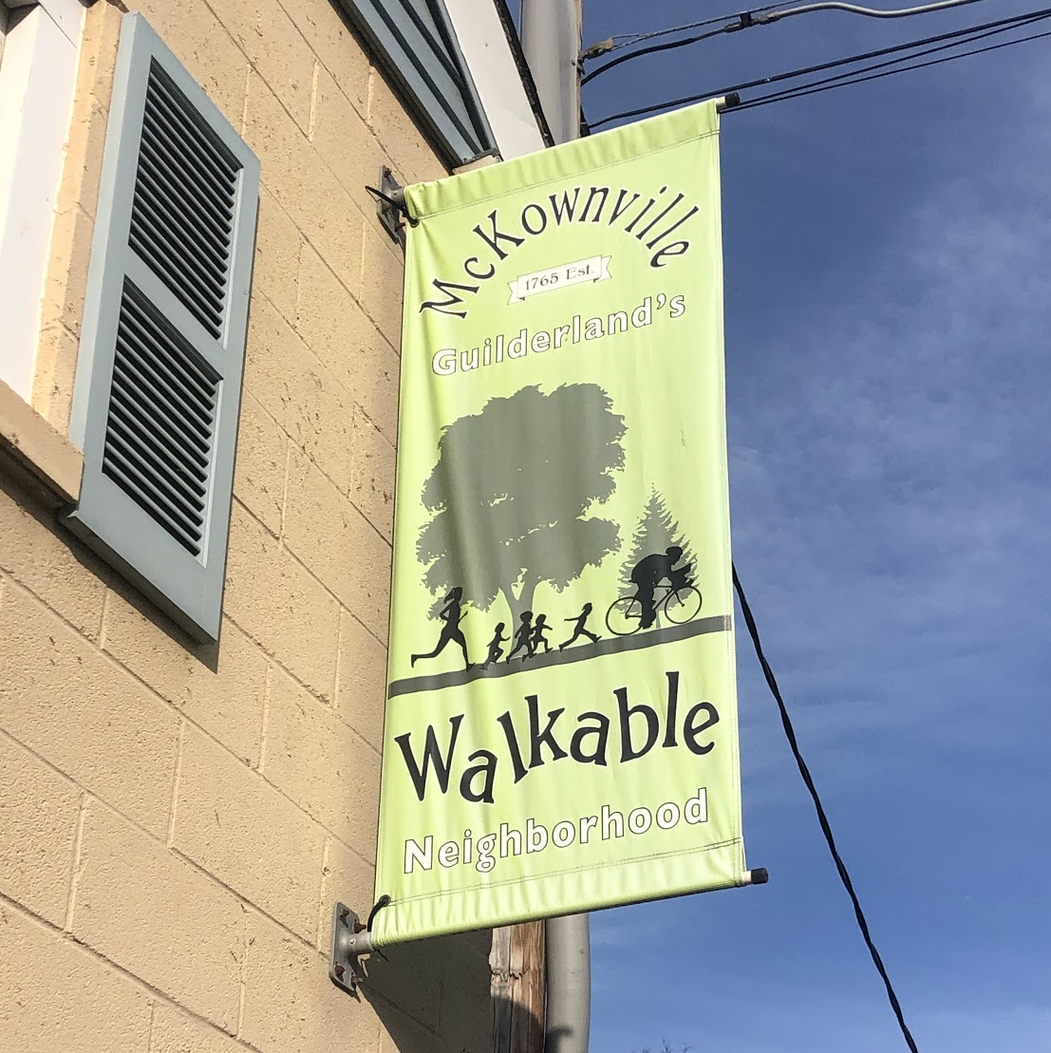
Existing Conditions & Previous Planning Efforts
Conducted existing conditions analysis of identified key sites
Topography
Presence of wetlands
Property ownership
Space available
Reviewed previous planning efforts dating back to 1987
Analyzed what plans/recommendations have come to fruition
Analyzed what plans/recommendations are still applicable present-day from previous efforts
Created new recommendations to assist in the overall objective of connectivity and walkability throughout Guilderland
Notes:
In order to better understand Guilderland’s progression over the years, the studio class reviewed previous planning efforts and studies dating back to 1987 to identify past practices and preferences. Previous planning efforts act as a guideline for Planning Studio’s scope of work. The Town of Guilderland has been proactive in its planning efforts over the years. This was particularly helpful when considering the existing conditions analysis. The existing conditions analysis was utilized as a starting point to examine the natural and built environment of designated sites that were identified as areas of immediate interest by town members. Prior to specific site recommendations, it was crucial for students to decipher between complete and incomplete recommendations from past plans and to analyze whether those recommendations are still applicable currently. Therefore, recommendations proposed by Studio are built upon the foundation of past efforts while propelling the town’s long-term objectives forward.

Slide 5
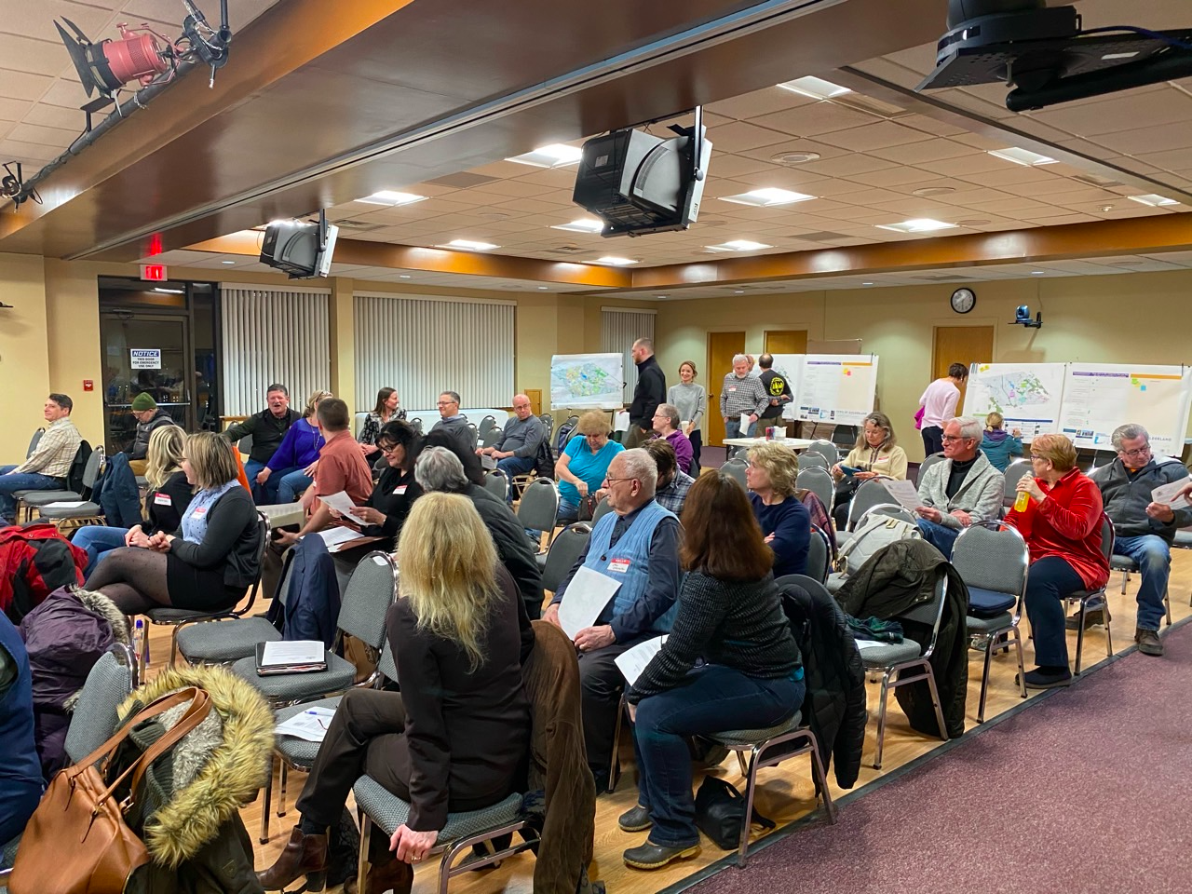
Community Engagement
Public meeting held on March 2nd, 2020:
Residents were able to identify on maps important potential trail connections
Comments cards were collected for general comments on what residents would want to see
Residents were able to “vote” on amenities they wanted to see more of in their parks
Greatest demands were for sidewalks and multi-use trails
Notes:
Community members are considered experts in their communities, public meetings provides them with the opportunity to utilize that expertise in a subtle yet helpful way. Students presented on prior plans and then took questions and concerns from residents.
At the public meeting held on March 2nd 2020
There were hands-on activities for residents to participate in.Providing interactive maps and anonymous comment cards creates a space for community members to leave honest comments and concerns. Studio members developed four hands on activities to obtain community feedback. A Pathways Committee Plan recommendation map and concerns, Existing conditions Town of Guilderland Map, an amenities checklist, and public comment cards.

Slide 6
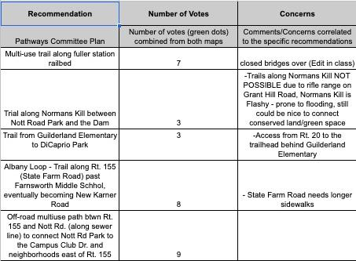
Community Engagement
Found residents were primarily concerned with more connectivity to community such as schools and inter-park connectivity
Students conducted stakeholder outreach by having conversations with community members identified by the Town
Gain a deeper understanding of what is important to the town and its residents.
Notes:
Based on the comments form the community the following recommendations were the most favorable; multi-use trails along fuller station railbed, off-road multi-use path between Rt. 155 and Nott Rd to connect Nott Rd Park and neighborhoods east of Rt. 155, and the Albany Loop- a trial along Rt, 155 past Farmsworth Middle School.

Slide 7
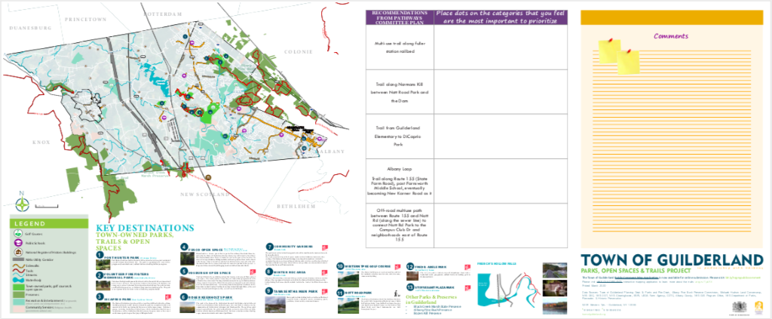

Identified Key Destinations
Notes:
This map and comment portion of the activity yielded the most results for community feedback. The map portion shows the key destinations for connectivity. Community members and stakeholders were encouraged to indicate on the map where they believe potential pathways would be useful in connecting parks to other parks, existing trails to parks, and where potential bike lanes could be implemented.

Slide 8
Overview of Recommended Trail Connections
www.townofguilderland.org
Notes:
We will now introduce the recommended trail connections for the Town selected sites within Guilderland. For more in-depth information the sites and recommendations, please review the draft final report available on the Town of Guilderland's website at www.townofguilderland.org

Slide 9
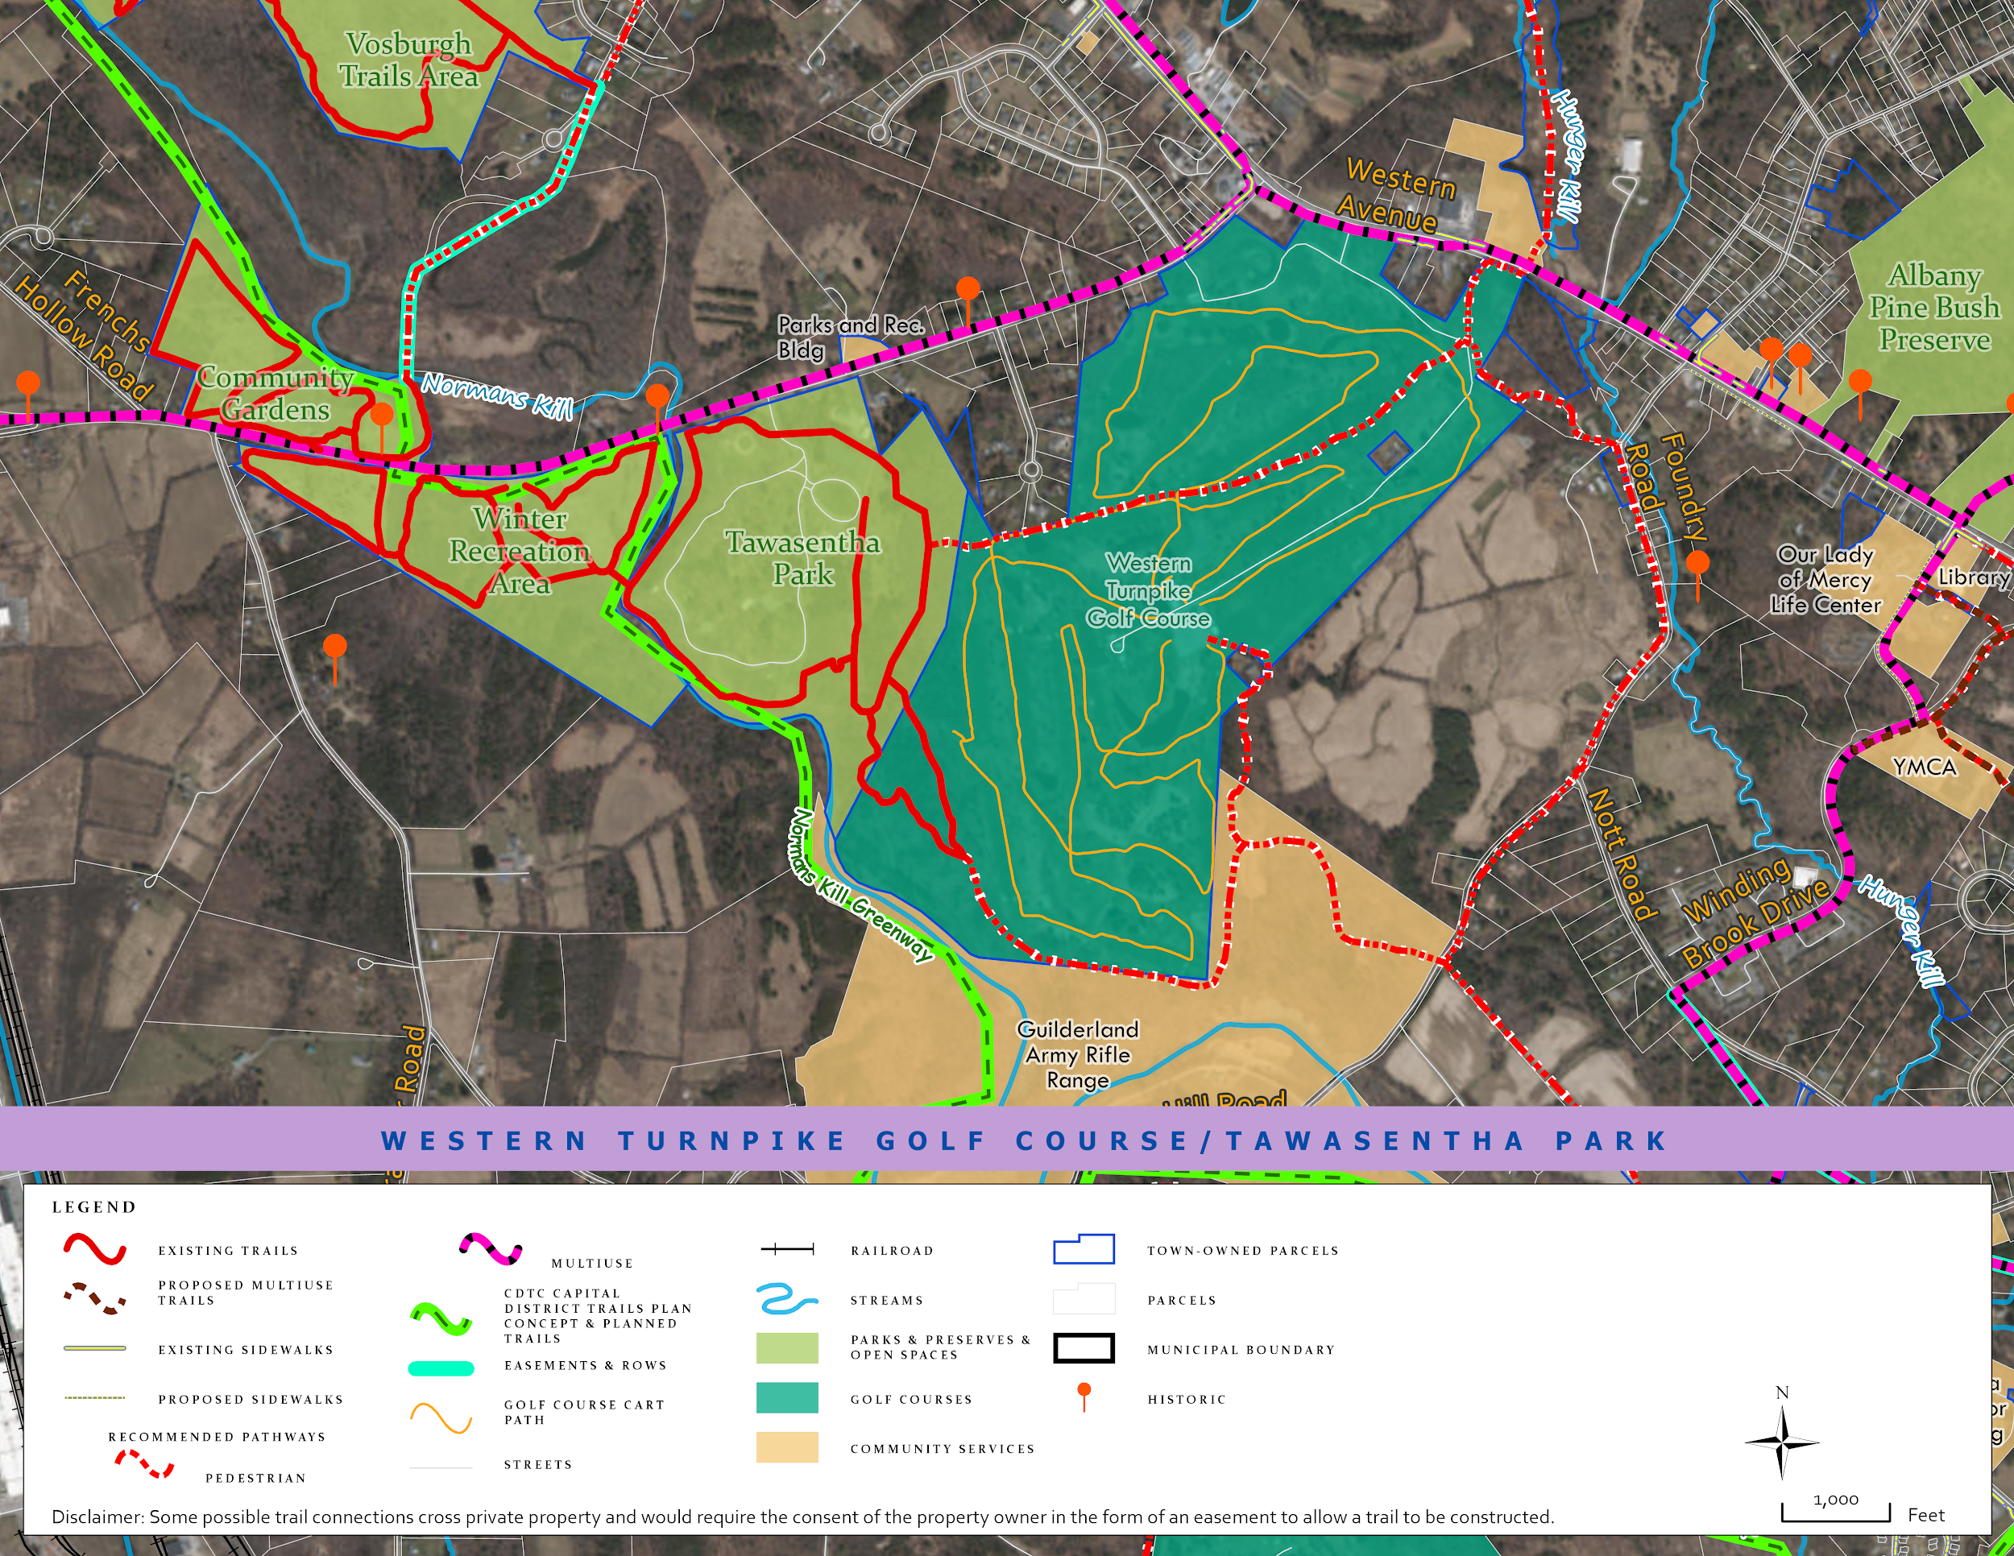

Recommendations for Winter Rec/Western Turnpike Golf Course
Main Connection exists between the Winter Rec Area and Tawasentha Park
Propose connection to the golf course via the outdoor theater of Tawasentha Park and the north side of the park
Existing trails will then connect Foundry Road, Nott Road, Winding Brook Lane
Historical Sites will also be added to the trail system
Rt 146 should be altered to accommodate pedestrian traffic

Slide 10
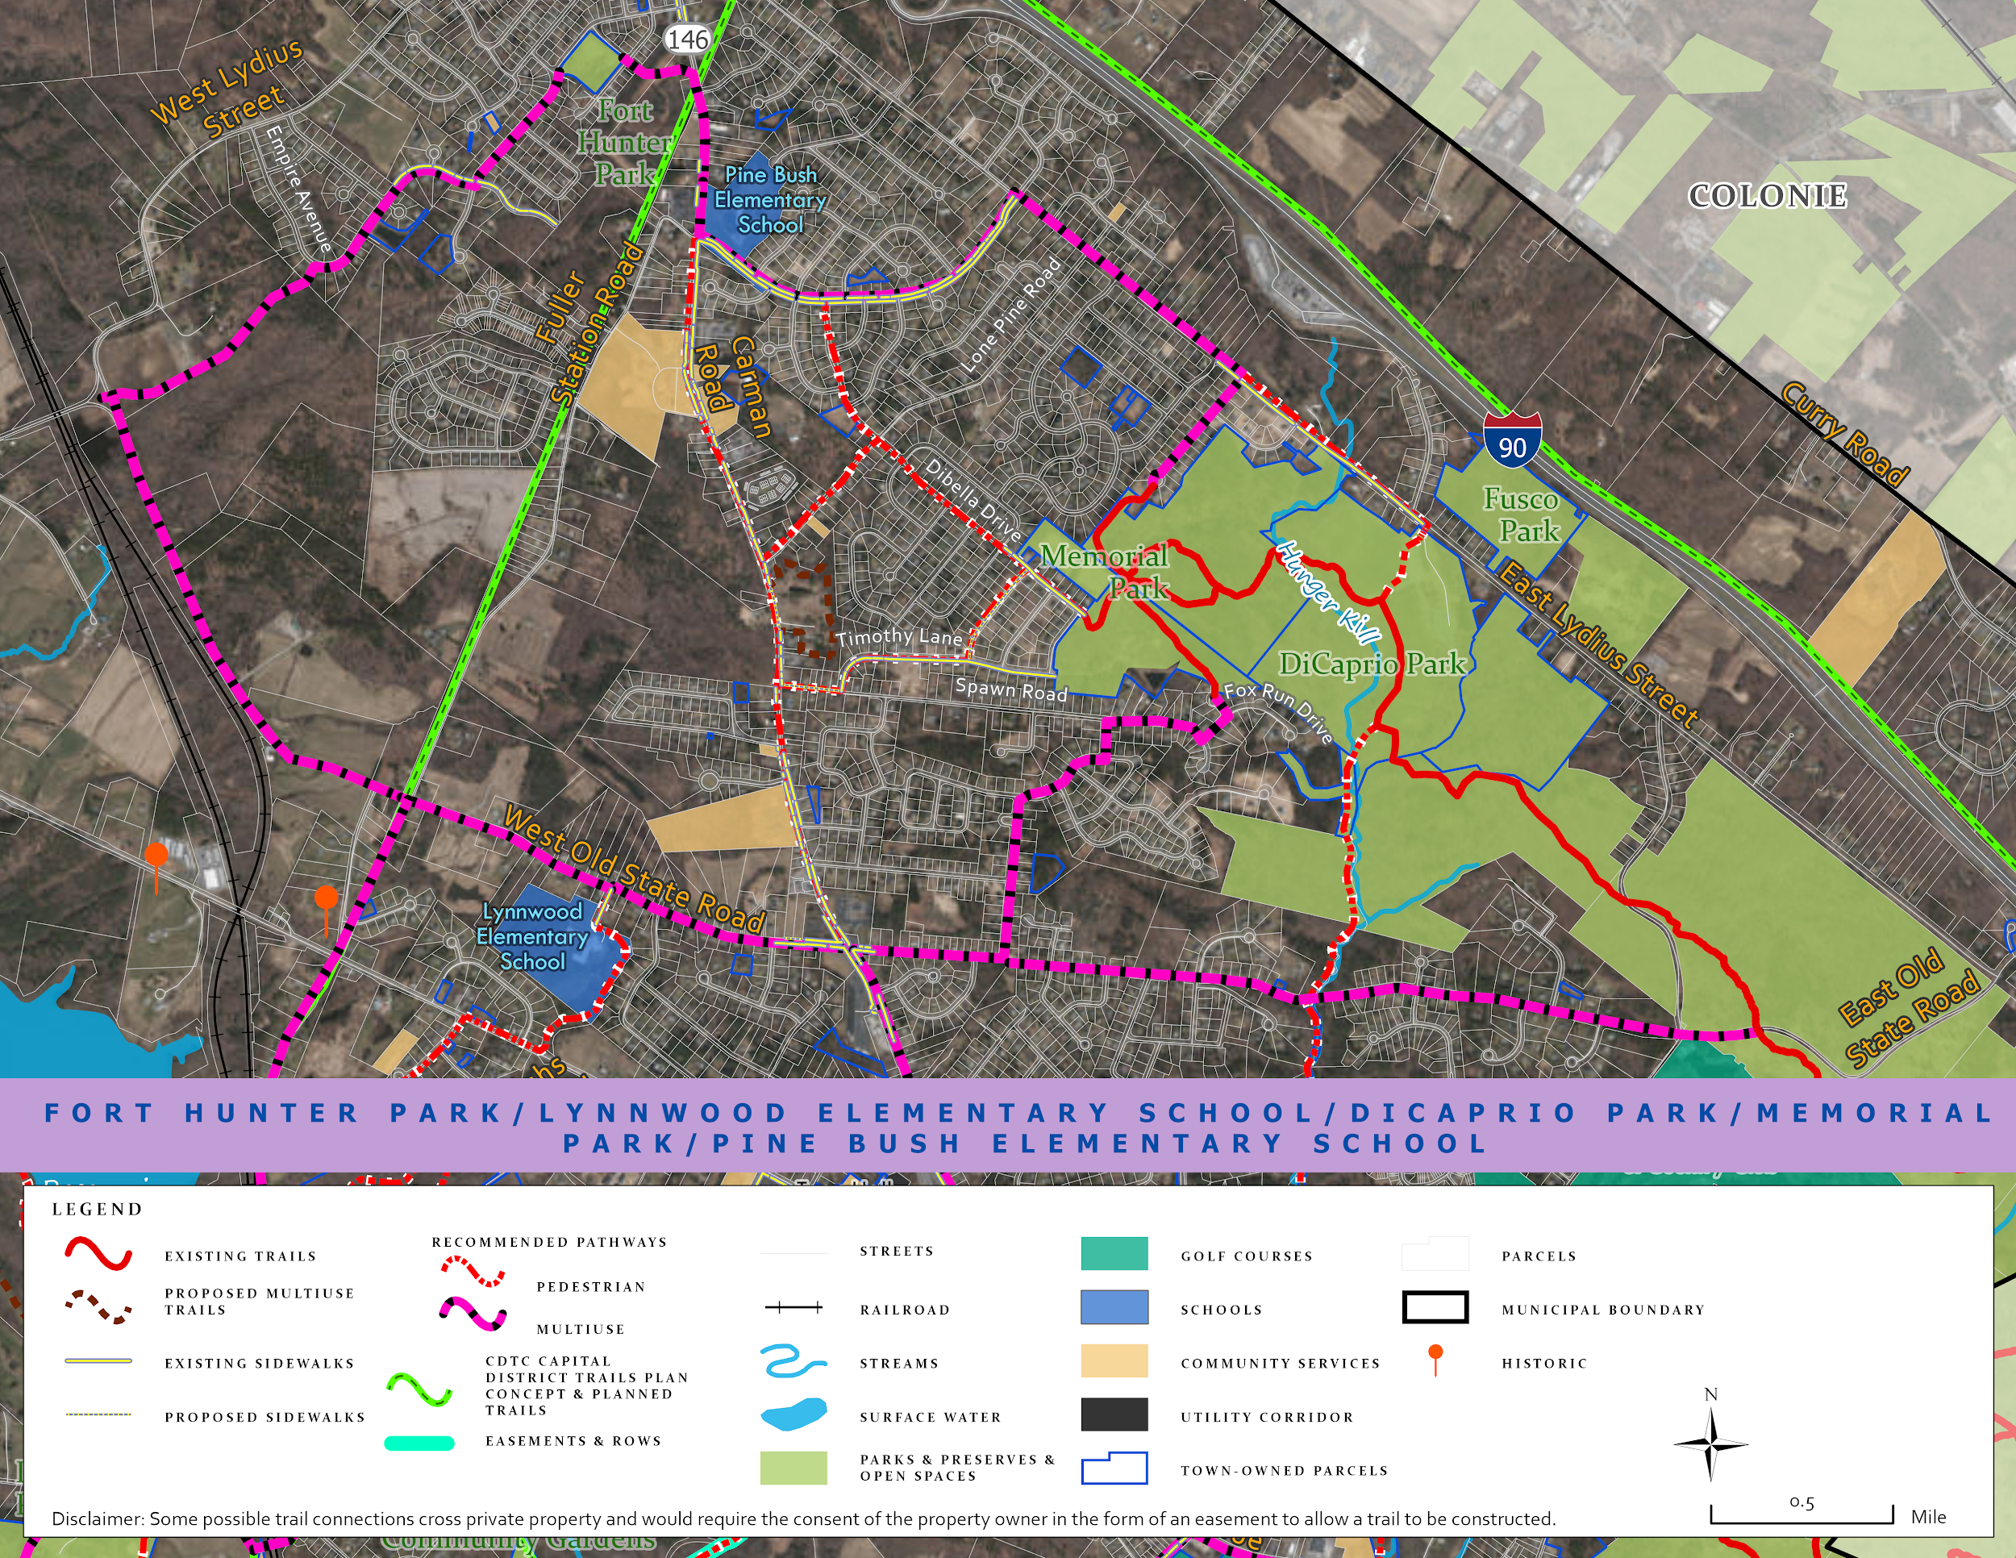
Recommendations for DiCaprio Park
Connections currently exist between the Albany Pine Bush and the Volunteer Firefighters Memorial Park
Potential trail exists to the south of the park via the Hunger Kill River
Protected land to the south of the PIne Bush has opportunities for trail implementation to connect Guilderland Elementary School

Slide 11
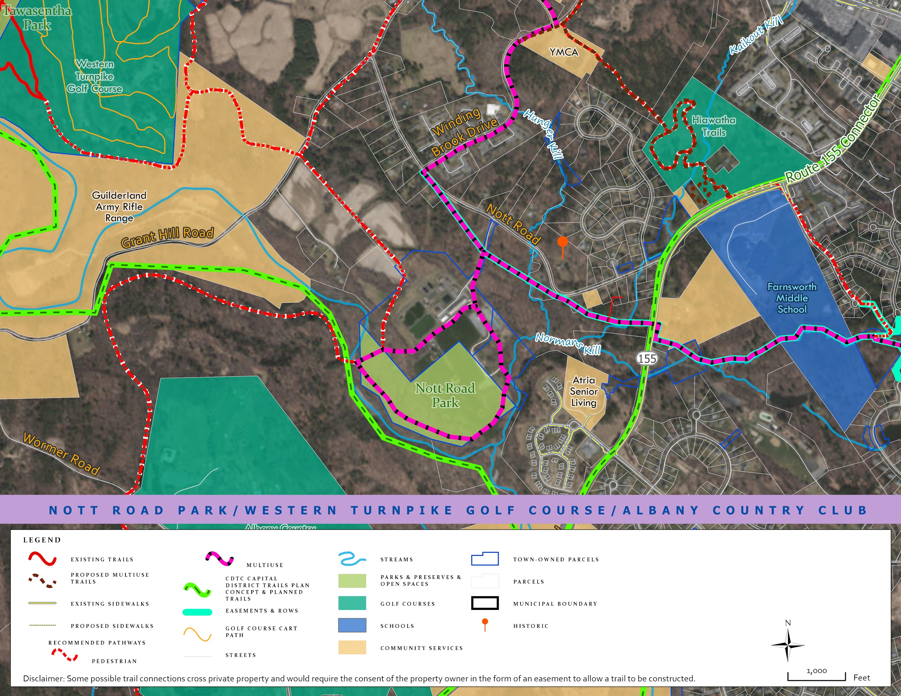
Recommendations for Nott Road Park
Central location and nearby town-owned parcels make this area a valuable intersection
Develop a multi-use loop trail surrounding the park
Utilize right of way for pathways
Connect with the CDTC proposed regional trail

Slide 12
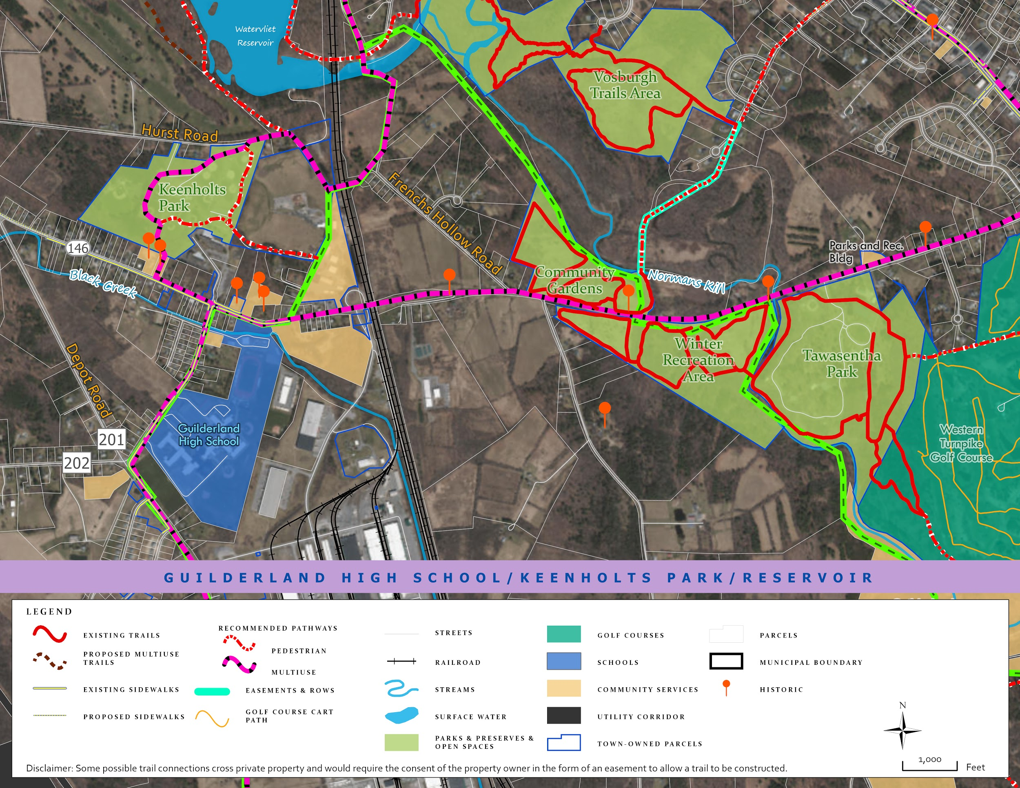
Recommendations for Roger Keenholts Park
Utilize the closed bridges to create a trail from French’s Hollow Falls
Using the open space near the landfill site, develop an interpretive/educational trail.
Connect Keenholts Park to Tawasentha and Guilderland High School

Slide 13
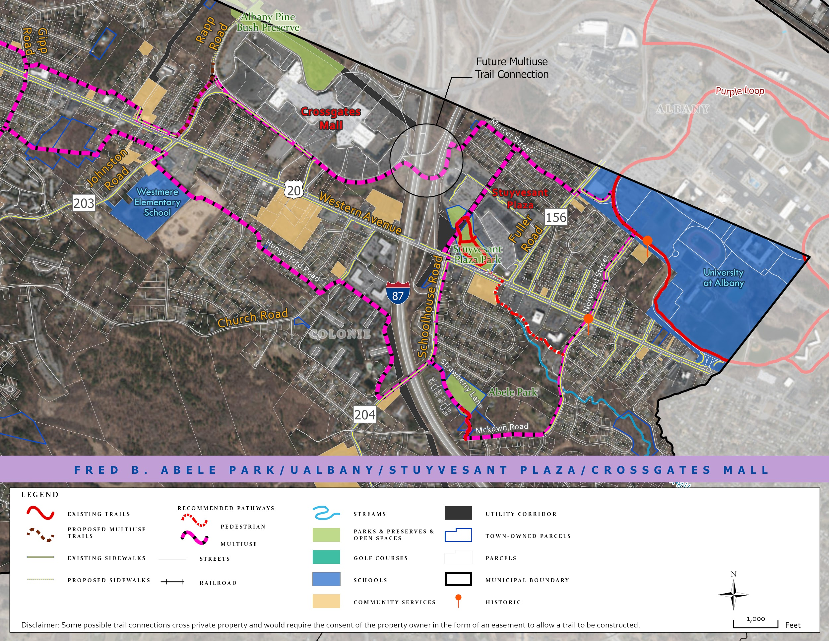
Recommendations for Fred Abele/McKownville Parks
Construct multi-use paths on:
Strawberry Lane
Schoolhouse Road
Fuller Road
Mckown Road
Norwood Street
Maintain and extend Power Line Path
Bike/ped connection between Stuyvesant Plaza and Crossgates Mall
Enhance park visibility via signage and beautification
Notes:
The overall goal of Studio’s work t

Slide 14
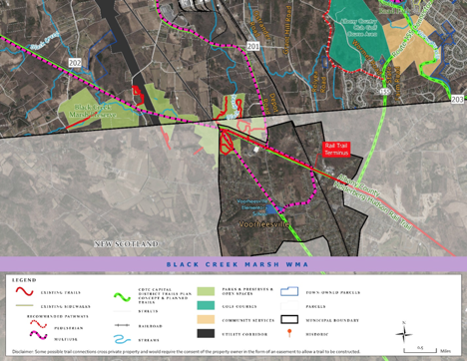
Black Creek Marsh Wildlife Management Area
CDTC Capital District Trail Plan - Proposed Trail
Extend the Albany County Helderberg-Hudson Rail Trail beyond Rail Trail Terminus in Voorheesville
Connect Black Creek Marsh Wildlife Area and Guilderland Center
Bike-related Roads Signs
Advisory Bike Lanes

Slide 15
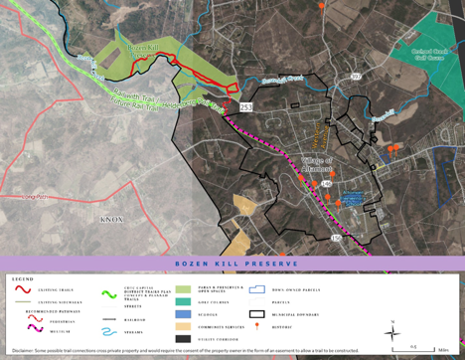
Recommendations for Bozen Kill Preserve
Improve Wayfinding
Mountain Bike Trails
CDTC Capital District Trail Plan – Proposed Trail
Extension of Rail Trail from Terminus in Voorheesville to Bozenkill Preserve

Slide 16
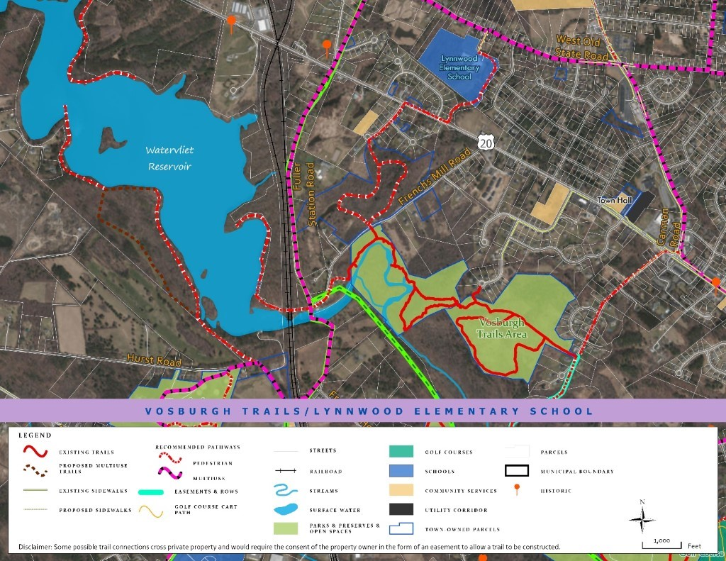
Recommendations for Watervliet Reservoir
Developing any trails along the Watervliet Reservoir requires coordinations between the City of Watervliet and the Town of Guilderland
Proposed trail includes extending the Vosburgh Trails around the reservoir to any potential recreation area that is agreed upon

Slide 17

Tawasentha Park
Create a pathway connecting Tawasentha Park to the Western Turnpike Golf Course

Slide 18
Recommendations for Albany Pine Bush Preserve
Establish a multi-use trail along the powerline to connect Pine Bush Preserve Yellow Trail to Rt. 155 (commonly referred to as the “Albany Loop”
Walking trail proposed as part of Winding Brook Commons Project
Multi-use trail alongside west boundary of Guilderland Elementary School.

Slide 19
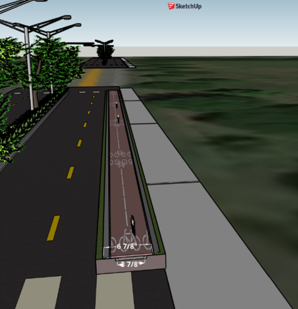
Historical Sites
Trails can amplify the importance of historical sites as well as create an educational component and identity for the town.
Historical sites
Battle of Normanskill – located across from Winter Recreation Area
Farm of Evert Bancker – Located on Route 146
Glass Works – located on the Corner of Farm Lane and Foundry Road
The Vale of Tawasentha – located to the west of Tawasentha Park
Retrofitting Route 146 to support bicyclists and hikers would allow these sites to be connected and walkable for residents
Visualization created on Sketchup of bike lanes and multi-use path along Route 146
Notes:
This offers a look into the historical background of the Town of Guilderland as well as potential sites for trail connectivity. After discussions with town officials, it has been concluded that the involvement of historical sites with trail implementation would be useful. The Town of Guilderland has a strong rural and industrial past that can be conveyed to the residents and visitors using the trail system. Not only will trails be used to amplify the importance of these sites but it will also add an educational component and a sense of identity for the town and its residents
With the rich historical context that the town possesses, it is only natural for many historical sites to exist within its boundaries. Some sites include the Battle of Normanskill which took place during the Revolutionary War, The Vale of Tawasentha, an old Native American burial ground, The Farm of Evert Banker who was the third mayor of Albany, and the Albany Glassworks site, which is considered to be one of the first glassworks in the United States.
These sites offer an amazing way to improve Guilderland’s trail system while also bringing the Town’s historical past and significance to light. Inclusion of historic sites through trails will also attract new hikers, promote education, and will connect the community with its rich heritage.

Slide 20
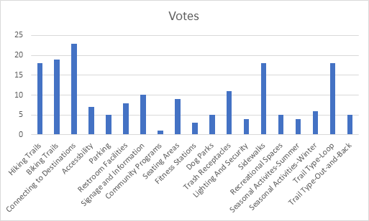
Trail Amenities and Marketing
Results from the public meeting indicated:
Hiking trails, biking trails, connection to destinations, sidewalks, and a trail-type loop were among the most important amenities for residents.
Additional quality of life amenities include seating areas, restrooms, and trash receptacles.
General multi-use trails would be most cost effective for the Town in trail development
The Town would benefit from more branded wayfinding throughout their trail systems
Improvements could include additional signage.
Notes:
Using the public comments on trail amenities, several recommendations can be made. There was almost equal interest in developing trails for hiking and biking, so a paved multi-use path would be the most cost effective implementation for the Town. Since loop trails were preferred over out-and-back trails, when appropriate, loop options should be prioritized. The community also identified seating areas, restrooms, and trash receptacles as being the most important amenities. Finally, it is recommended that the town increase and develop their wayfinding and branding for their parks and trails.

Slide 21
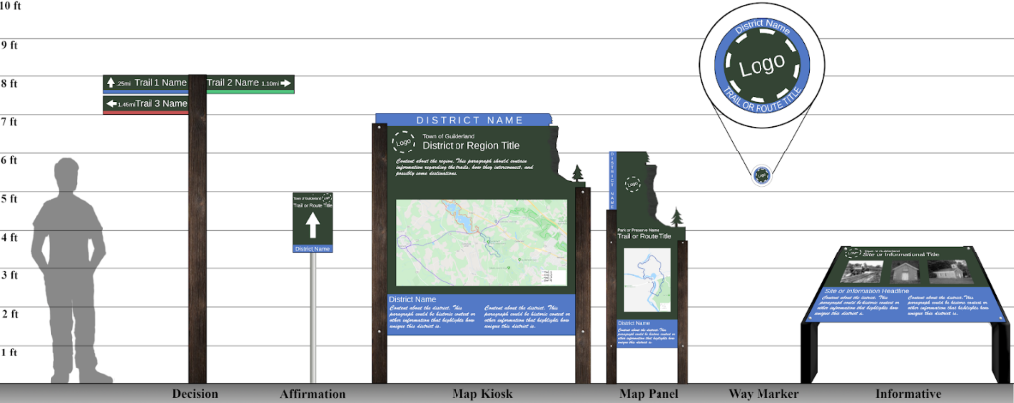
Wayfinding
Helderberg Escarpment incorporated into the wayfinding shown
Notes:
Wayfinding is the system that provides guidance, typically using signage, to ensure that trail users are comfortable knowing where to go. These six types of signs were identified to assist user navigation. “Decision” signs should be placed in locations where users have multiple trail options and need to decide which trail to take. “Affirmation” signs reassure the user that they are on the correct path. These should be placed in locations where there may be a brief interruption of the trail, like an intersecting road. “Map Kiosks” are regional maps that show how multiple trails interconnect. “Map Panels” depict specific trails and their amenities. These should be placed at the beginning of trails. “Way Markers” are small, circular signs, typically nailed to trees, that provide continuous affirmation that the user is on the intended path. It is recommended that the town develop and implement a consistent sign design theme using these categories to create a sense of continuity between all of their parks and trails.

Slide 22

Branding
Use “Hike Guilderland!” as a branded phrase for wayfinding.
Ubiquitous symbols like suns and trees make easily recognizable symbols for logos.
Notes:
Using repetitive slogans, logos, and wayfinding creates an “identity” that can be associated with the town’s trails and parks. The town has previously began building their branding using the phrase “Hike Guilderland!”, so that phrase should be continued to maintain consistency. It is recommended that the town develop a recognizable logo that can be quickly associated with its trail systems using symbols commonly associated with the outdoors like trees, mountains, or the sun. Using a capital “G” to represent “Guilderland”, four example logos were developed.

Slide 23
Funding
The Town could explore using municipal allocations as a funding mechanism for their projects. This could include having a dedicated tax stream, budget allocations, or dedicating portions of existing revenue or increasing fees for Town services.
The Consolidated Funding Application would be submitted for various State operating grants dedicated to the improvement or planning of trails and recreation in municipalities.
There are also State operated Federal grants that the town could apply for by working with partners at the County level to increase accessibility to trails for neighboring towns and cities.
Notes:
Securing funding is crucial to the implementation of any project. This section explores various methods of funding for Guilderland’s trail development. Funding could be accessed through municipal allocation. This could be done via a dedicated tax stream, direct budget allocation, or dedicated portions of existing revenue or fees towards trail development. This method may involve community outreach to gather interest from residents on how effective this method would be.
Various State and Federal grants are also outlined in this section. As these grants are statewide, Guilderland would be competing with other municipalities. All the grants listed in the section fund trail development in some way, whether it be implementation planning or building the trail itself. Guilderland is eligible for all grants listed in the report.
New York’s streamlined Consolidated Funding Application can be submitted for multiple grants allowing Guilderland to not have duplicative work in applying for funding.

Slide 24
Thank you to the Town of Guilderland for your help and participation!
We encourage and appreciate your feedback!
www.townofguilderland.org
Notes:
This presentation has provided an overall summary of the findings and recommendations of the project. We wish to thank the Town of Guilderland and the public for their support in preparing this plan. We encourage you to review the full document also on the Town of Guilderland's website at twww.townofguilderland.org, and submit any comments on this effort to the Town of Guilderland Planning staff."

